Slide 1
Learning to recover orientations from projections in Single-Particle Cryo-EM
林思涵

Slide 2
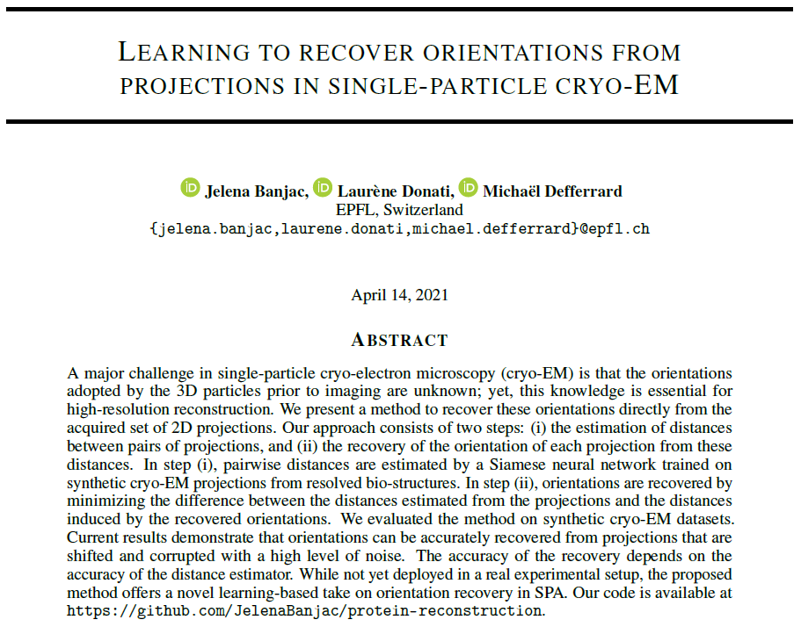

Slide 3
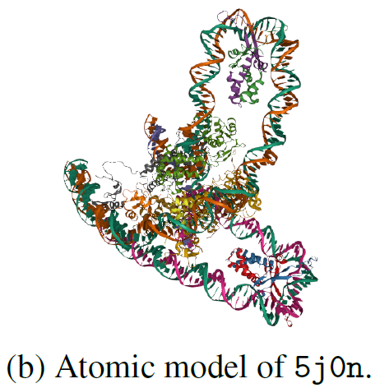
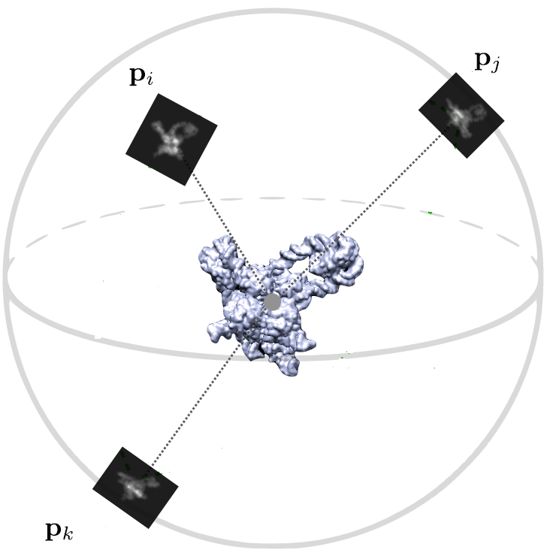
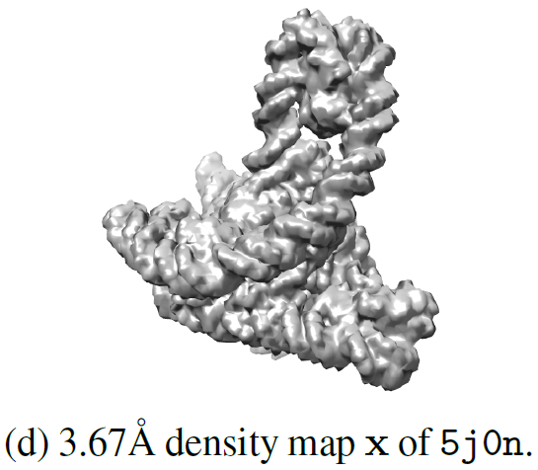
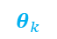

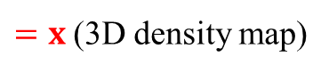
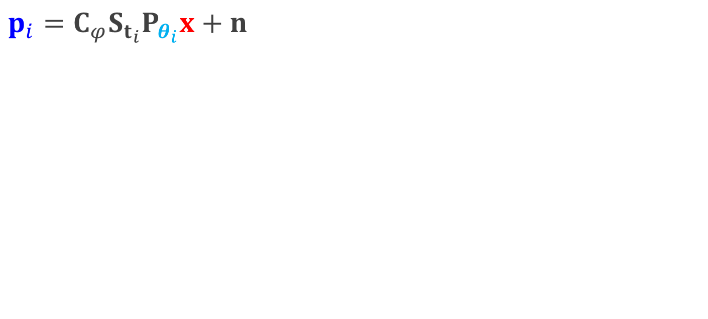
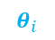
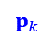
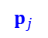
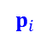
Cryo-EM Model
$$p_{i}=C_{φ}S_{t_{i}}P_{θ_{i}}x+n$$
$$p_{i}$$
$$p_{j}$$
$$θ_{j}$$
$$θ_{i}$$
$=x$ (3D density map)
$$θ_{k}$$
$$p_{k}$$

Slide 4
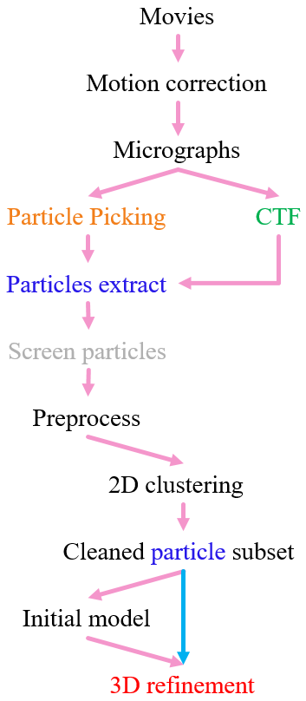
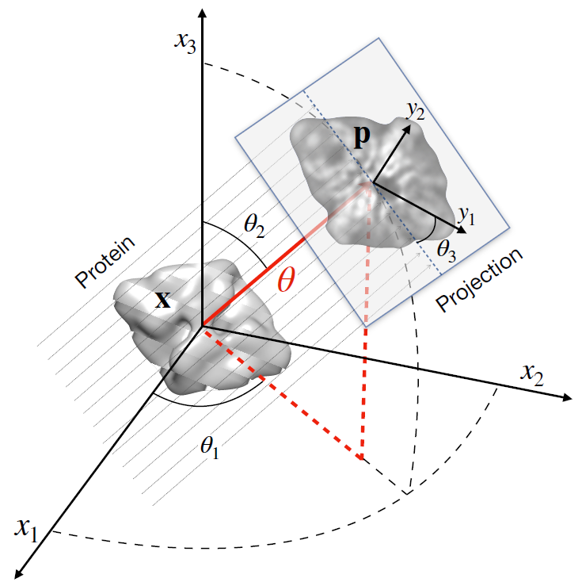
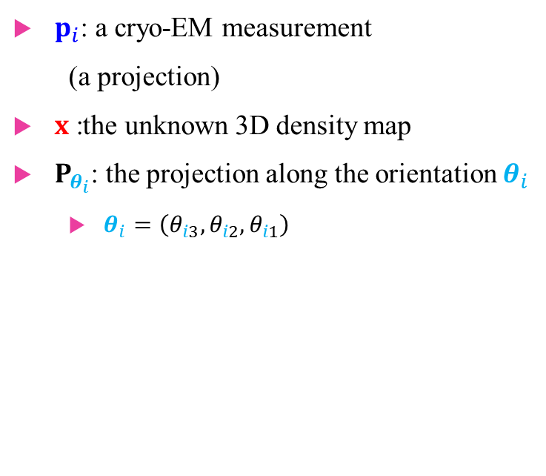

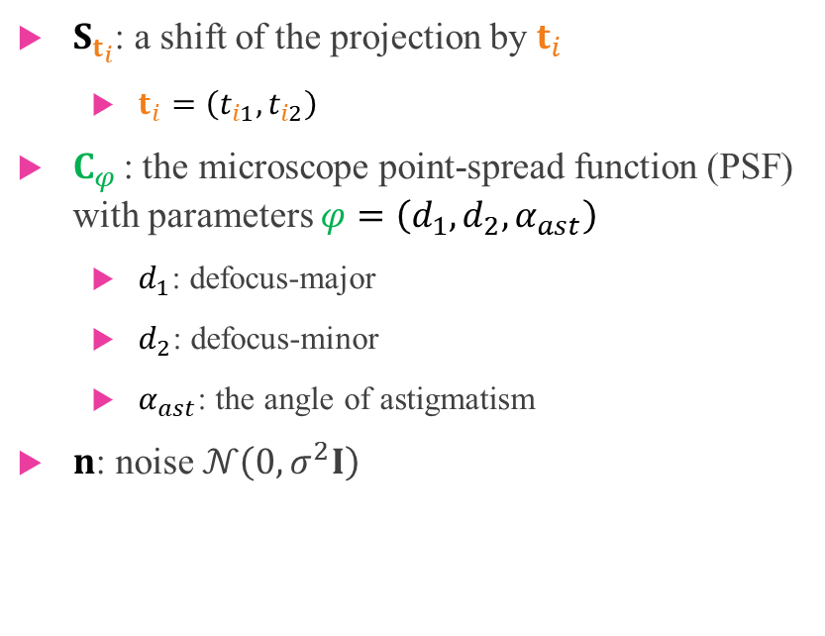
Cryo-EM Model $$p_{i}=C_{φ}S_{t_{i}}P_{θ_{i}}x+n$$
$p_{i}$: a cryo-EM measurement
(a projection)
$x$ :the unknown 3D density map
$P_{θ_{i}}$: the projection along the orientation $θ_{i}$
$θ_{i}=\left(θ_{i3},θ_{i2},θ_{i1}\right)$
$S_{t_{i}}$: a shift of the projection by $t_{i}$
$t_{i}=\left(t_{i1},t_{i2}\right)$
$C_{φ}$: the microscope point-spread function (PSF) with parameters $φ=\left(d_{1},d_{2},α_{ast}\right)$
$d_{1}$: defocus-major
$d_{2}$: defocus-minor
$α_{ast}$: the angle of astigmatism
$n$: noise $𝒩\left(0,σ^{2}I\right)$

Slide 5
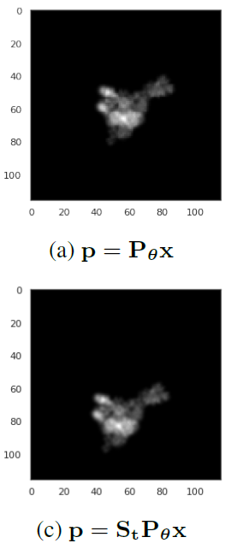
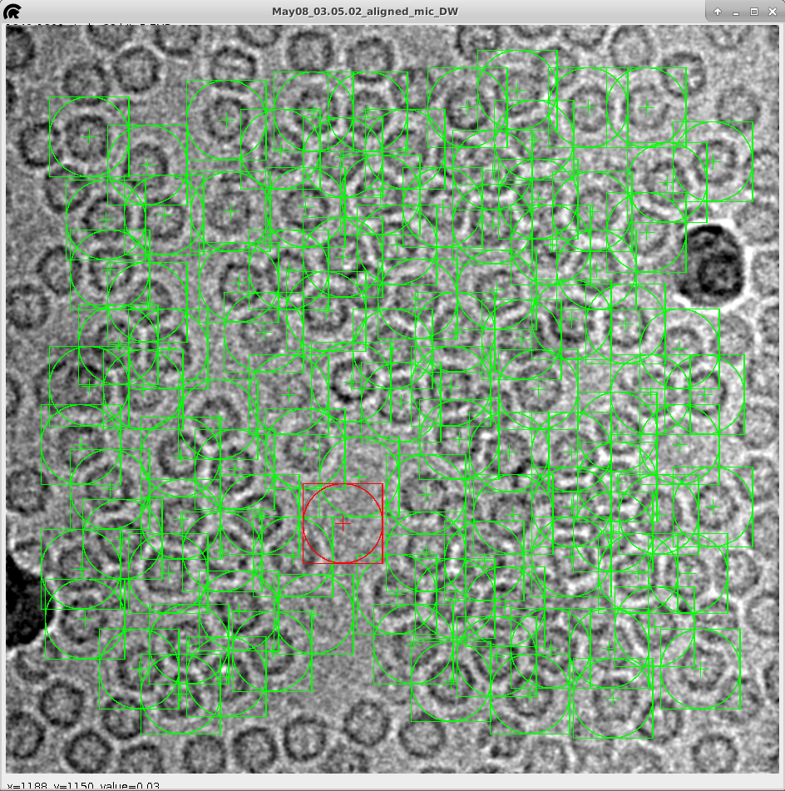
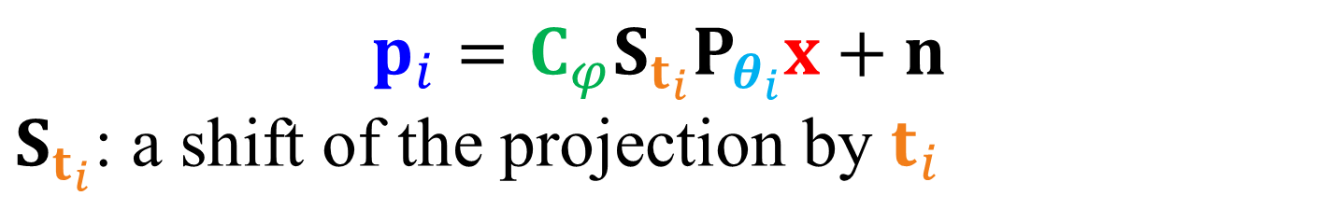
$$p_{i}=C_{φ}S_{t_{i}}P_{θ_{i}}x+n$$ $S_{t_{i}}$: a shift of the projection by $t_{i}$
Cryo-EM Model
示意圖:
圈選出來的particle不見得在正中間

Slide 6

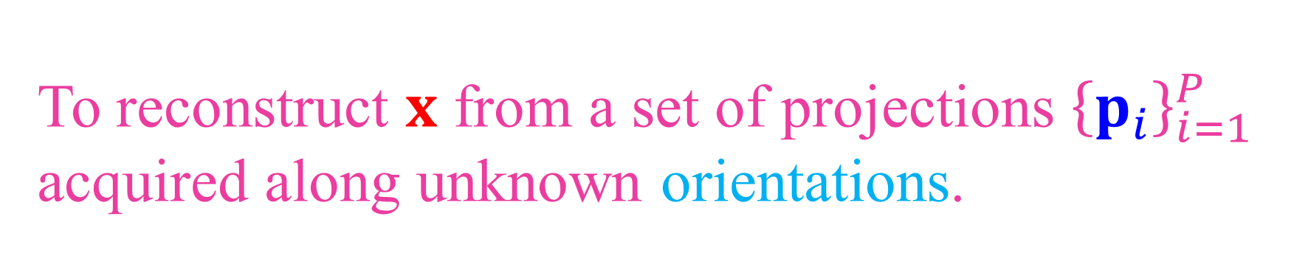
To reconstruct $x$ from a set of projections ${\left\{p_{i}\right\}}_{i=1}^{P}$ acquired along unknown orientations.
Cryo-EM Model $$p_{i}=C_{φ}S_{t_{i}}P_{θ_{i}}x+n$$

Slide 7
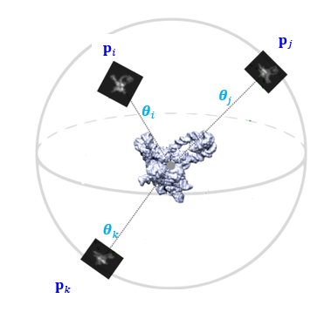
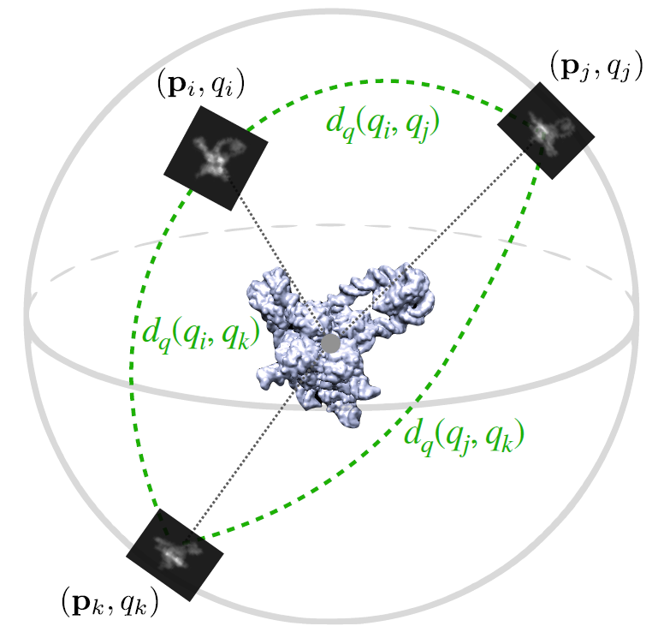
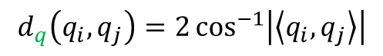
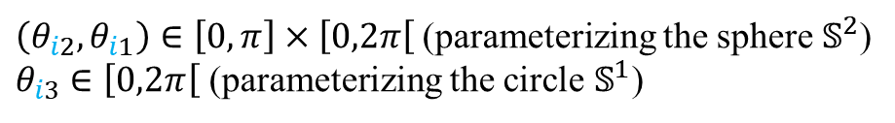
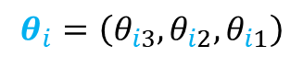
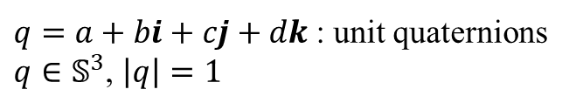
$$θ_{i}=\left(θ_{i3},θ_{i2},θ_{i1}\right)$$
$\left(θ_{i2},θ_{i1}\right)∈\left[0,π\right]×\left[0,2π\right[$ (parameterizing the sphere $𝕊^{2}$)
$θ_{i3}$ $∈\left[0,2π\right[$ (parameterizing the circle $𝕊^{1}$)
The distance between two orientations (rad)
$$d_{q}\left(q_{i},q_{j}\right)=2\cos^{−1}\left|\left\langle q_{i},q_{j}\right\rangle \right|$$
$q=a+bi+cj+dk$ : unit quaternions
$q∈𝕊^{3}$, $\left|q\right|=1$

Slide 8
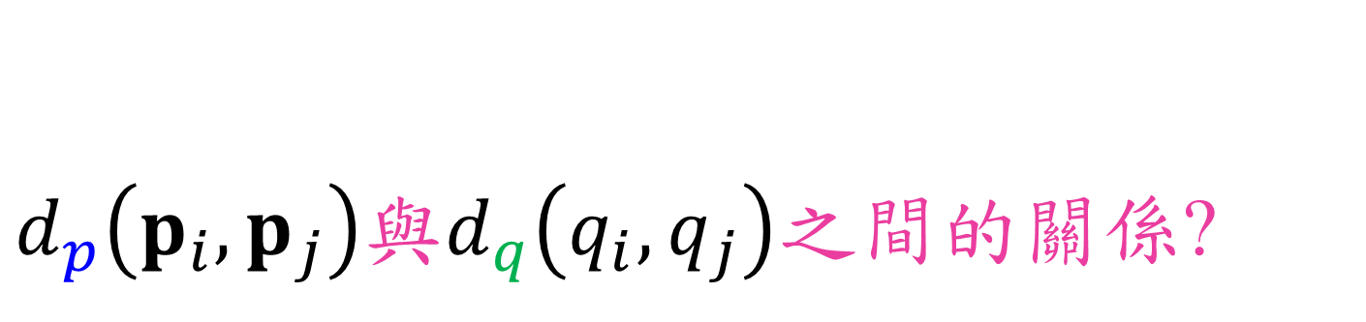
$d_{p}\left(p_{i},p_{j}\right)$與$d_{q}\left(q_{i},q_{j}\right)之間的關係$?
Cryo-EM Model $$p_{i}=C_{φ}S_{t_{i}}P_{θ_{i}}x+n$$

Slide 9
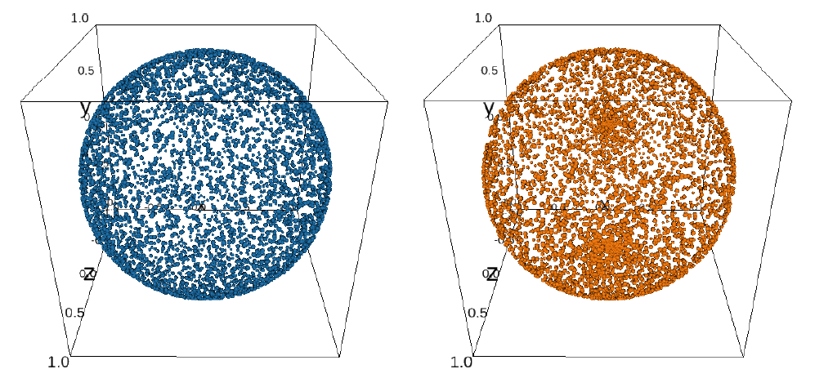
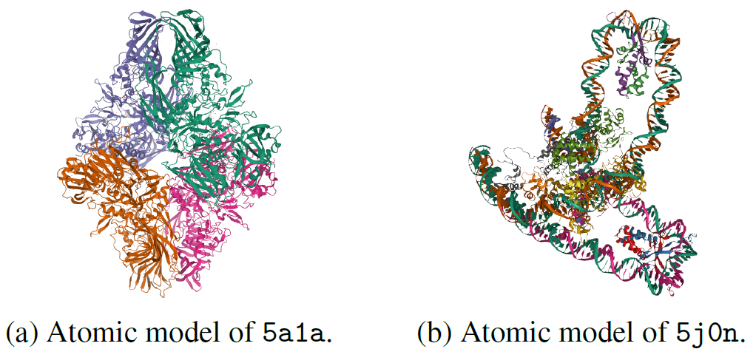
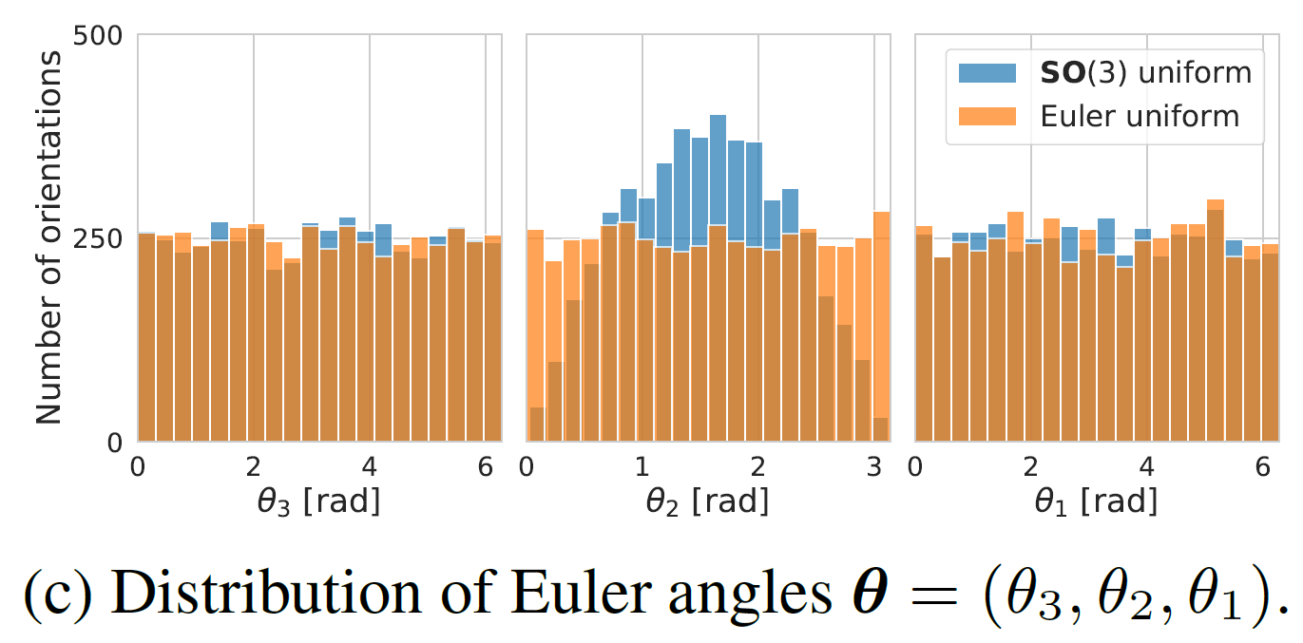
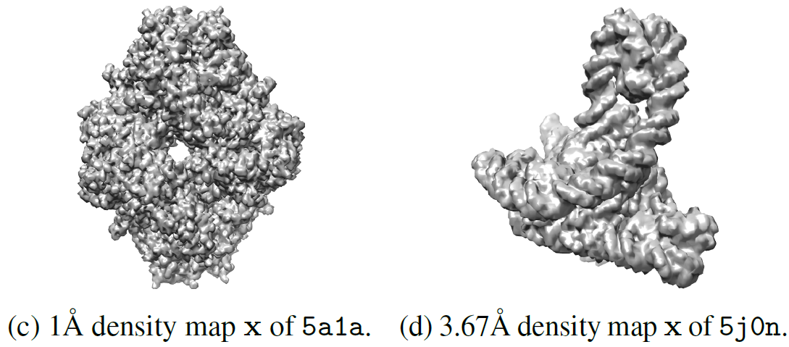
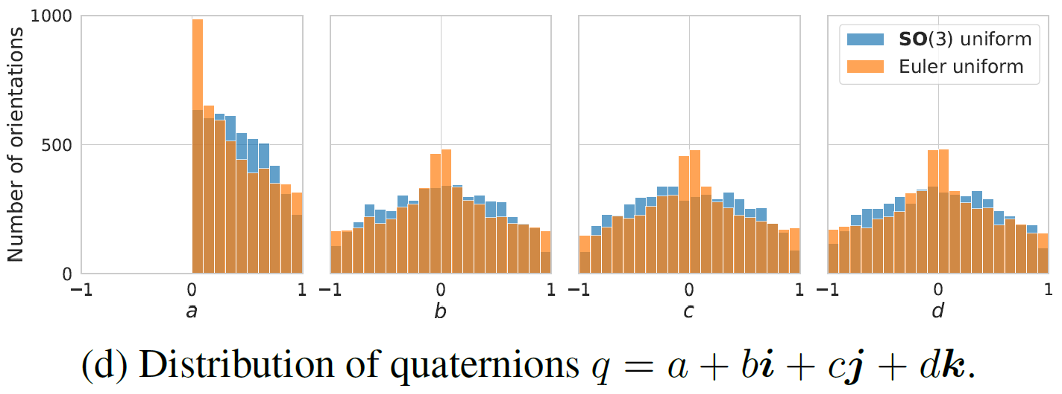
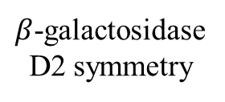
Simulation – 5000 projections
Orientations
Data
$β$-galactosidase
D2 symmetry
Lambda excision HJ intermediate
C1 symmetry

Slide 10
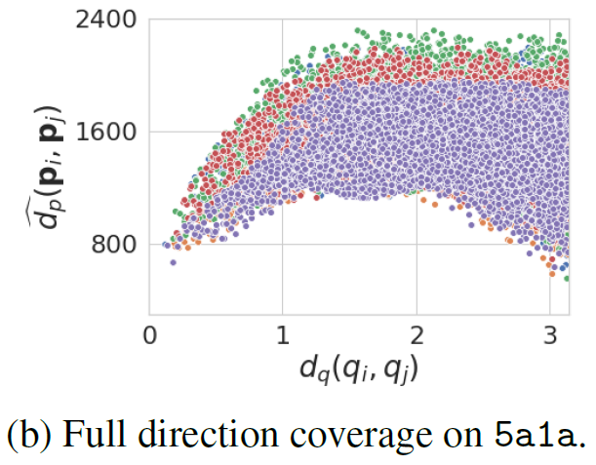
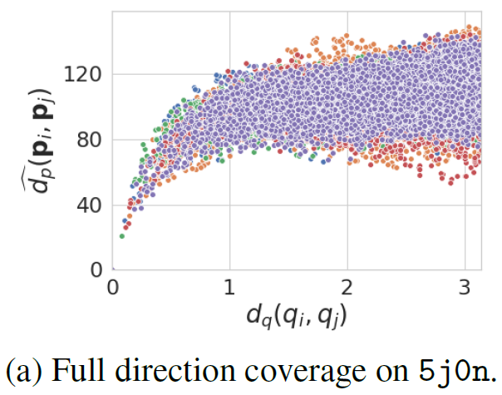
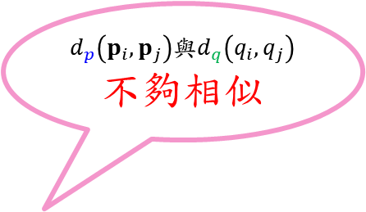
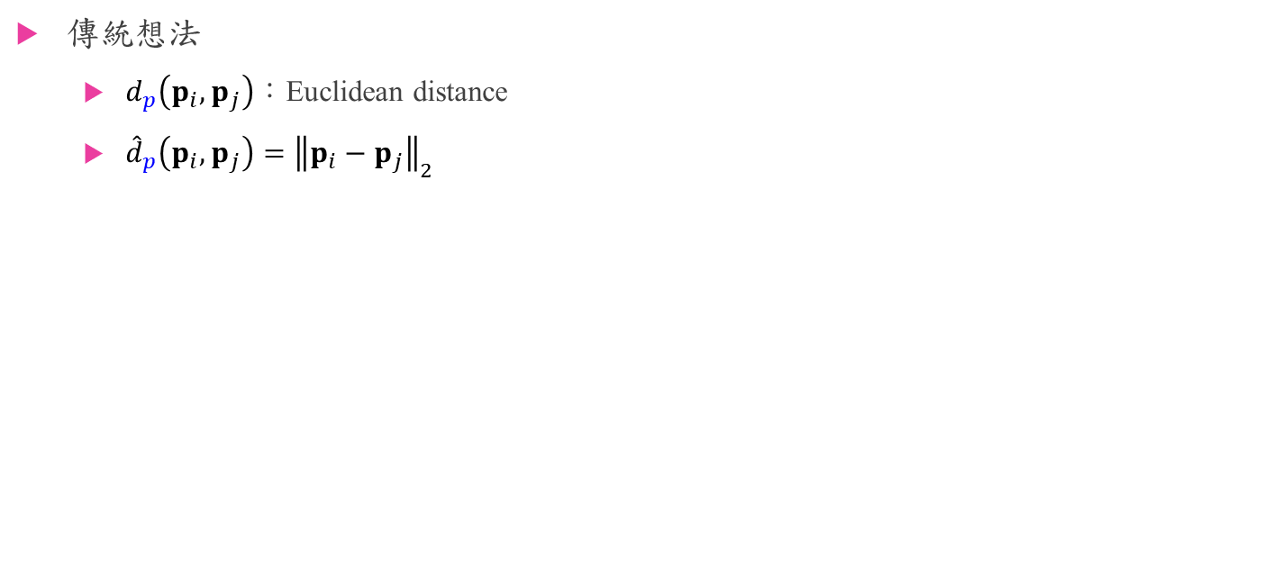
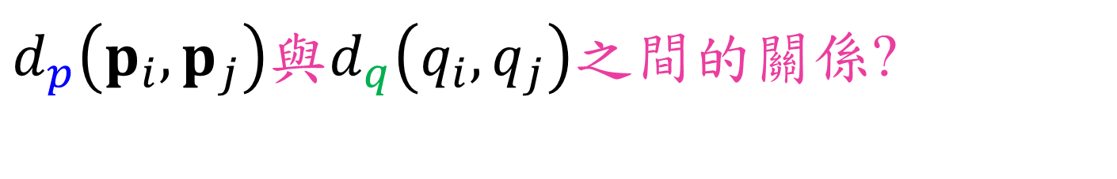
$d_{p}\left(p_{i},p_{j}\right)$與$d_{q}\left(q_{i},q_{j}\right)之間的關係$?
傳統想法
$d_{p}\left(p_{i},p_{j}\right)$：Euclidean distance
${\hat{d}}_{p}\left(p_{i},p_{j}\right)={\left\|p_{i}−p_{j}\right\|}_{2}$
$d_{p}\left(p_{i},p_{j}\right)$與$d_{q}\left(q_{i},q_{j}\right)$不夠相似
No noise, no shift, no PSF!

Slide 11
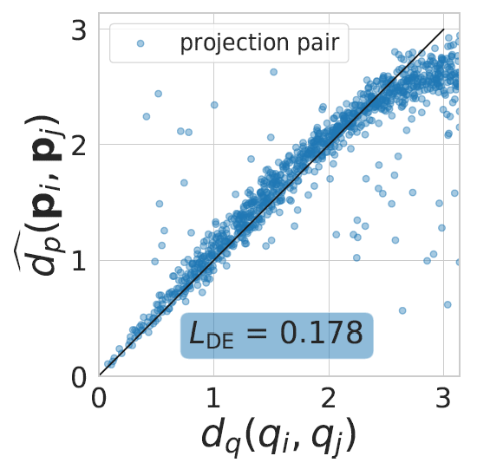
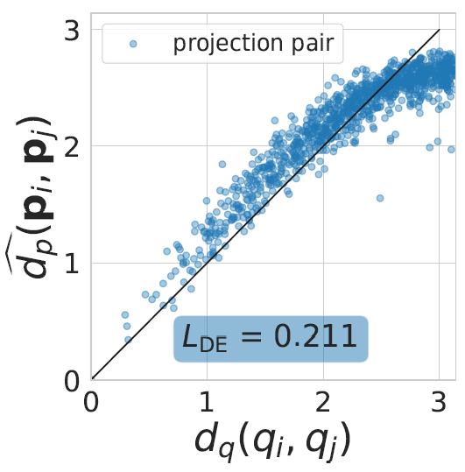
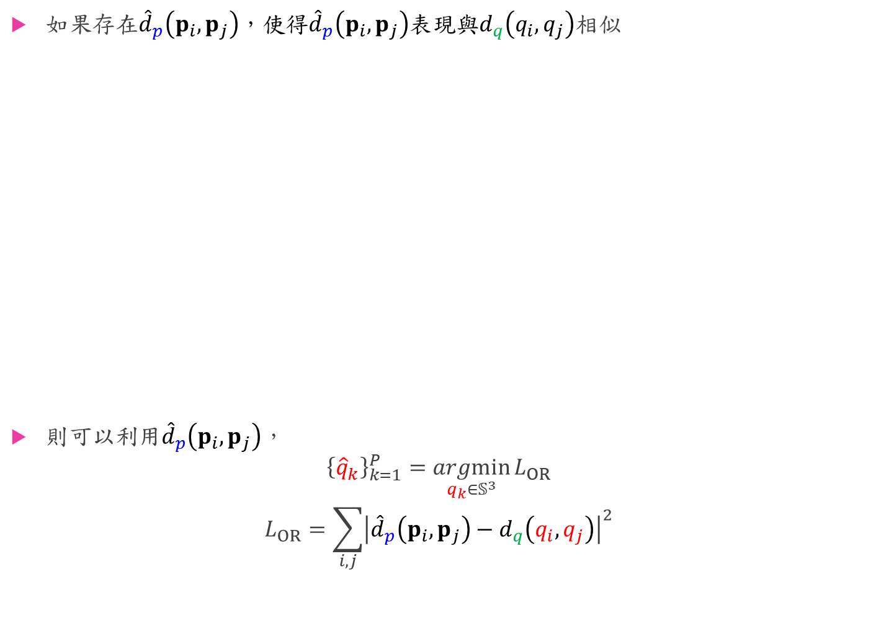

如果存在${\hat{d}}_{p}\left(p_{i},p_{j}\right)$，使得${\hat{d}}_{p}\left(p_{i},p_{j}\right)$表現與$d_{q}\left(q_{i},q_{j}\right)$相似
則可以利用${\hat{d}}_{p}\left(p_{i},p_{j}\right)$，
$${\left\{{\hat{q}}_{k}\right\}}_{k=1}^{P}=\underset{q_{k}∈𝕊^{3}}{argmin}{L_{OR}}$$
$$L_{OR}=\sum_{i,j}{{\left|{\hat{d}}_{p}\left(p_{i},p_{j}\right)−d_{q}\left(q_{i},q_{j}\right)\right|}^{2}}$$
$$d_{q}\left(q_{i},q_{j}\right)=2\cos^{−1}\left|\left\langle q_{i},q_{j}\right\rangle \right|$$

Slide 12
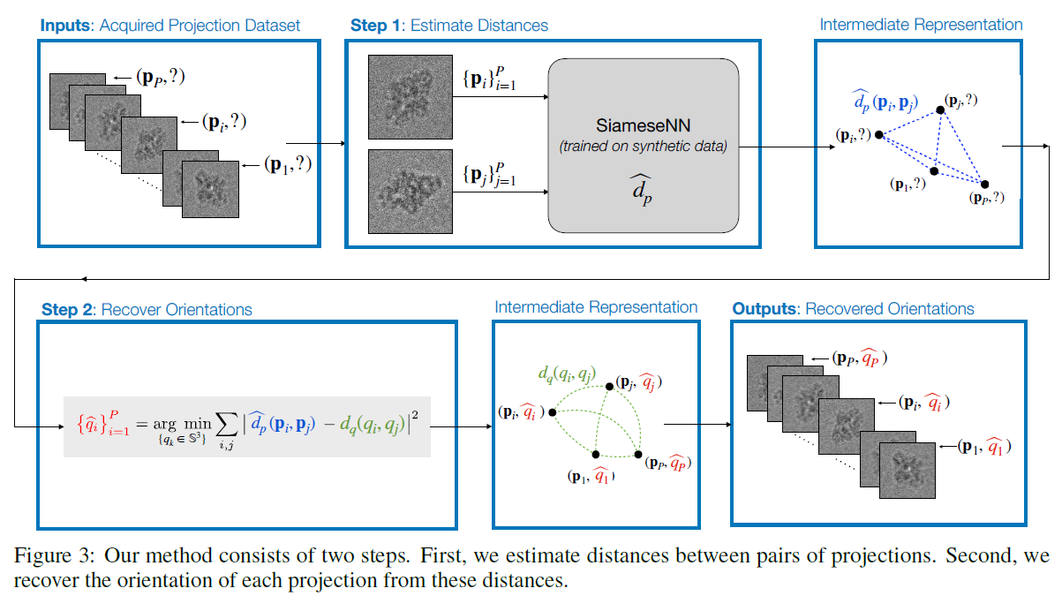
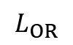
$$L_{OR}$$

Slide 13
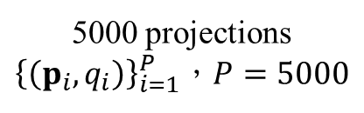
Simulation
5000 projections
${\left\{\left(p_{i},q_{i}\right)\right\}}_{i=1}^{P}$，$P=5000$
Training
50%
Validation
17%
Test
33%

Slide 14
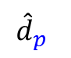
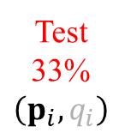
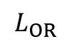
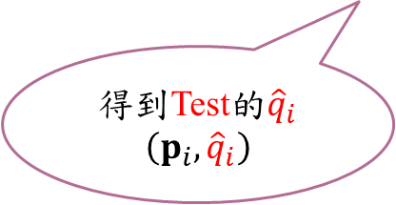

Simulation
Training
50%
Validation
17%
+
將${\hat{d}}_{p}$應用在Test
的$p_{i}$上
$${\hat{d}}_{p}$$
Test
33%
$$\left(p_{i},q_{i}\right)$$
$$L_{OR}$$
5000 projections
${\left\{\left(p_{i},q_{i}\right)\right\}}_{i=1}^{P}$，$P=5000$
得到Test的${\hat{q}}_{i}$
$$\left(p_{i},{\hat{q}}_{i}\right)$$
Training
50%
Validation
17%
Test
33%

Slide 15
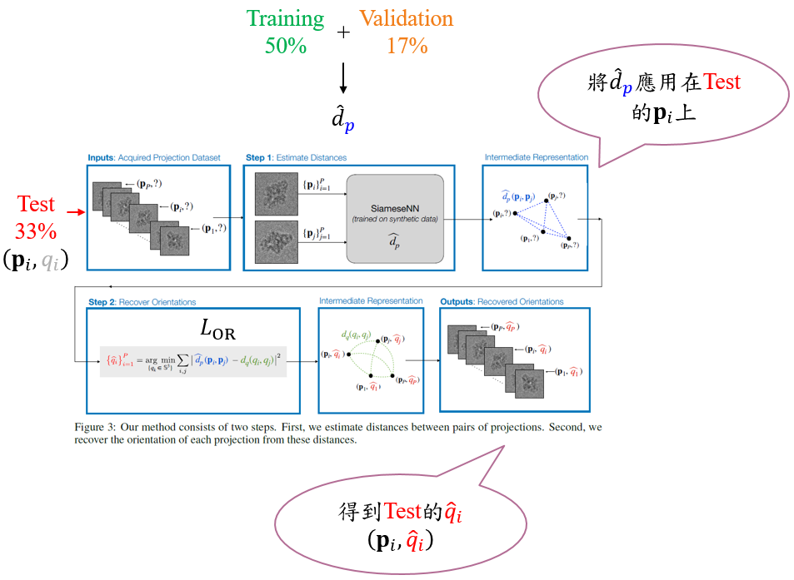
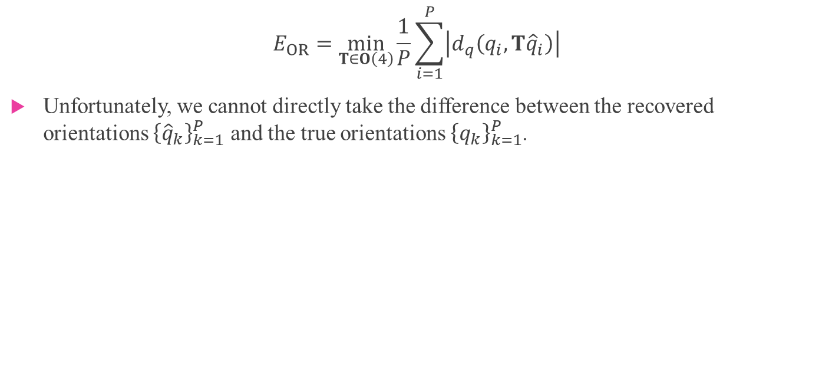
Evaluation
$$E_{OR}=\min_{T∈O\left(4\right)}{\frac{1}{P}\sum_{i=1}^{P}{\left|d_{q}\left(q_{i},T{\hat{q}}_{i}\right)\right|}}$$
Unfortunately, we cannot directly take the difference between the recovered orientations ${\left\{{\hat{q}}_{k}\right\}}_{k=1}^{P}$ and the true orientations ${\left\{q_{k}\right\}}_{k=1}^{P}$.

Slide 16
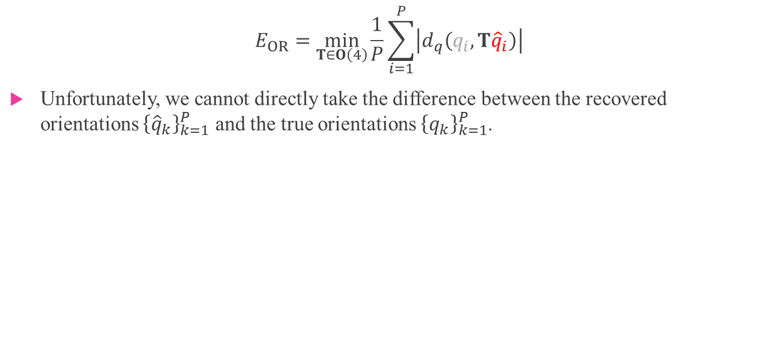
Evaluation
$$E_{OR}=\min_{T∈O\left(4\right)}{\frac{1}{P}\sum_{i=1}^{P}{\left|d_{q}\left(q_{i},T{\hat{q}}_{i}\right)\right|}}$$
Unfortunately, we cannot directly take the difference between the recovered orientations ${\left\{{\hat{q}}_{k}\right\}}_{k=1}^{P}$ and the true orientations ${\left\{q_{k}\right\}}_{k=1}^{P}$.

Slide 17

如果$d_{p}\left(p_{i},p_{j}\right)$不用Euclidean distance 還可以怎麼得到${\hat{d}}_{p}\left(p_{i},p_{j}\right)$?

Slide 18




SiameseNN
Chopra, Sumit, Raia Hadsell, and Yann LeCun.
"Learning a similarity metric discriminatively, with application to face verification."
2005 IEEE Computer Society Conference on Computer Vision and Pattern Recognition (CVPR'05). Vol. 1. IEEE, 2005.
Validation
17%
Training
50%
$$\left(p_{i},q_{i}\right)$$
$${\hat{d}}_{p}\left(p_{i},p_{j}\right)$$

Slide 19



SiameseNN
Training
50%
$$\left(p_{i},q_{i}\right)$$
輸入：
目的：
找到$𝒢_{w}$，將$p_{i}$轉換成$f_{i}=𝒢_{w}\left(p_{i}\right)∈ℝ^{n_{f}}$
$$d_{p}\left(p_{i},p_{j}\right)=d_{f}\left(𝒢_{w}\left(p_{i}\right),𝒢_{w}\left(p_{j}\right)\right)$$
利用SiameseNN，去學習$𝒢_{w}$，使得
$${\hat{d}}_{p}=\underset{d_{p}}{argmin}{L_{DE}}$$
$$L_{DE}=\sum_{i,j}{{\left|d_{p}\left(p_{i},p_{j}\right)−d_{q}\left(q_{i},q_{j}\right)\right|}^{2}}$$
$$L_{DE}=\sum_{i,j}{{\left|d_{f}\left(𝒢_{w}\left(p_{i}\right),𝒢_{w}\left(p_{j}\right)\right)−d_{q}\left(q_{i},q_{j}\right)\right|}^{2}}$$

Slide 20


SiameseNN
$d_{f}\left(f_{i},f_{j}\right)$有兩種選擇
1. $d_{f}\left(f_{i},f_{j}\right)={\left\|f_{i}−f_{j}\right\|}_{2}$，Euclidean
2. $d_{f}\left(f_{i},f_{j}\right)=2\cos^{−1}\left(\frac{\left\langle f_{i},f_{j}\right\rangle }{\left\|f_{i}\right\|∙\left\|f_{j}\right\|}\right)$，Cosine
輸入：$\left(p_{i},q_{i}\right)$
目的：
找到$𝒢_{w}$，將$p_{i}$轉換成$f_{i}=𝒢_{w}\left(p_{i}\right)$
$$d_{p}\left(p_{i},p_{j}\right)=d_{f}\left(𝒢_{w}\left(p_{i}\right),𝒢_{w}\left(p_{j}\right)\right)$$
利用SiameseNN，去學習$𝒢_{w}$，使得
$${\hat{d}}_{p}=\underset{d_{p}}{argmin}{L_{DE}}$$
$$L_{DE}=\sum_{i,j}{{\left|d_{p}\left(p_{i},p_{j}\right)−d_{q}\left(q_{i},q_{j}\right)\right|}^{2}}$$
$$L_{DE}=\sum_{i,j}{{\left|d_{f}\left(𝒢_{w}\left(p_{i}\right),𝒢_{w}\left(p_{j}\right)\right)−d_{q}\left(q_{i},q_{j}\right)\right|}^{2}}$$

Slide 21


SiameseNN
$d_{f}\left(f_{i},f_{j}\right)$有兩種選擇
1. $d_{f}\left(f_{i},f_{j}\right)={\left\|f_{i}−f_{j}\right\|}_{2}$，Euclidean
2. $d_{f}\left(f_{i},f_{j}\right)=2\cos^{−1}\left(\frac{\left\langle f_{i},f_{j}\right\rangle }{\left\|f_{i}\right\|∙\left\|f_{j}\right\|}\right)$，Cosine
輸入：$\left(p_{i},q_{i}\right)$
目的：
找到$𝒢_{w}$，將$p_{i}$轉換成$f_{i}=𝒢_{w}\left(p_{i}\right)∈ℝ^{n_{f}}$
$$d_{p}\left(p_{i},p_{j}\right)=d_{f}\left(𝒢_{w}\left(p_{i}\right),𝒢_{w}\left(p_{j}\right)\right)$$
利用SiameseNN，去學習$𝒢_{w}$，使得
$${\hat{d}}_{p}=\underset{d_{p}}{argmin}{L_{DE}}$$
$$L_{DE}=\sum_{i,j}{{\left|d_{p}\left(p_{i},p_{j}\right)−d_{q}\left(q_{i},q_{j}\right)\right|}^{2}}$$
$$L_{DE}=\sum_{i,j}{{\left|d_{f}\left(𝒢_{w}\left(p_{i}\right),𝒢_{w}\left(p_{j}\right)\right)−d_{q}\left(q_{i},q_{j}\right)\right|}^{2}}$$

Slide 22

SiameseNN
Training
50%
Validation
17%
+

Slide 23

Experiments
Cryo-EM Model $p_{i}=C_{φ}S_{t_{i}}P_{θ_{i}}x+n$，$n\sim 𝒩\left(0,σ^{2}I\right)$

Slide 24


Training
50%
Validation
17%
+
Test
33%
($L_{DE}$)
($L_{OR}$)

Slide 25












Training
50%
Validation
17%
Test
33%
Data
Reconstruction

Slide 26


Training
50%
Validation
17%
Test
33%
Data
Reconstruction

Slide 27
The End

